Slide 1
Food Insecurity and Obesity
By Sophia Harris, Sam McFarland, Esal Shakil, Nika Yermakova

Slide 2
Overview
01
04
02
05
03
Cluster Analysis
Report Update
Moderation Analysis
Next steps
Visualizations-

Slide 3
01
Cluster Analysis
Now that we have our data clustered, we attempted to create a visualization out of it!

Slide 4
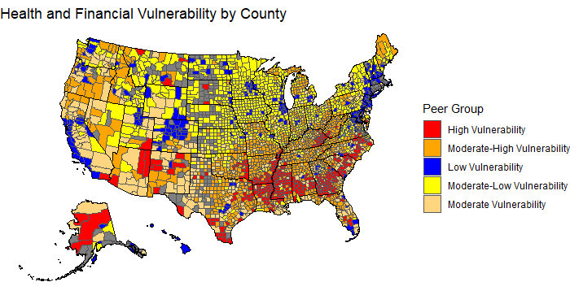
Cluster Analysis Visualization
Notes:
Factor variable - attaching order to variables
Ordered factor in r
Ask which variables have the most mising data - it might be better to drop that variable - instead of using 20, use 18 which has more complete data
Get historical boundaries for thos things? From the census beuru??
We can get geometeries for the old counties instead of the new counties
It’s a mismatch between our data set and the map boundaries
Look at each variable and figure out where there are missing variables
Imputation - mean imputation
What is it about rural colorado that makes it so blue
Wha is it about ht either characteristics of the clusters that makes it this way
What draws these things together both geoegraphically and both health and financial stuff - characterize it more
Unpacking that, there is a lot of interesting stuff

Slide 5
Some Issues to Resolve for Next Week
Potentially Fix the NA values? - the issue is that we had to remove them in order to run the cluster analysis.
Get better colors/order for the clusters.
Determine how to label each cluster so that there is more information describing each one.
Ensure that we are following proper grammar of graphics principles.
Create interactive features that would allow the user to fully optimize the information provided by the graph (as much as we can at this point).

Slide 6
02
Moderation Analysis
Last week we wanted to run a mediation analyses. However, after some consideration, we decided to do a moderation analysis instead.

Slide 7
Moderation over Mediation
Why did we decide against mediation?
Mediation occurs when the relationship between an independent variable and a dependent variable is explained by a third variable (the mediator).
However, our data lacks variables for mediation. Our variables are better at explaining what leads to food insecurity, instead of how food insecurity leads to obesity. To put it simply:
We wanted our mediation model to look like this: Food Insecurity → Variable A → Variable B → Obesity.
Instead, with our variables, it would look like this: Variable A → Variable B → Food Insecurity → Obesity.
Furthermore, based on past literature, we found that the relationship between food insecurity and obesity can be explained somewhat directly, without the use of mediation.

Slide 8
Moderation over Mediation
Why did we choose moderation?
Moderation refers to the influence of a third variable (the moderator) on the relationship between two other variables - It helps understand when the relationship between two variables changes.
This aligns with our data more since, based on research, most of our variables can’t necessarily explain the relationship between food insecurity and obesity.
However, our variables can potentially change that relationship, by making it stronger or weaker.
This also aligns with our goal in examining the relationship between our variables more directly, with food insecurity as the independent variable and obesity as the dependent variable.

Slide 9
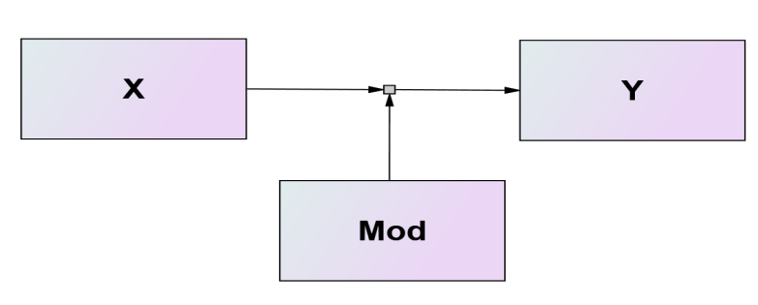
Visual Example

Slide 10
Choosing the Moderating variables
Since our data has 18 potential variables, we had to do some research on what would make good moderators.
Based on existing literature, we chose the following variables to investigate:
Income Disparities: Median income
Education Levels: Less than college education
Demographic Factors: People of color
Geographical Factors: Rural Population
So, we are interested in the following:
Does the degree by which food insecurity
influence obesity change depending on the levels of
chosen variables?
Why these variables?
Many studies found that these variables are associated with food insecurity and obesity.
However, there were limited studies examining if there is a stronger or weaker relationship between food insecurity and obesity depending on median income, race, education, and population levels.
So that is what we are going to do.

Slide 11
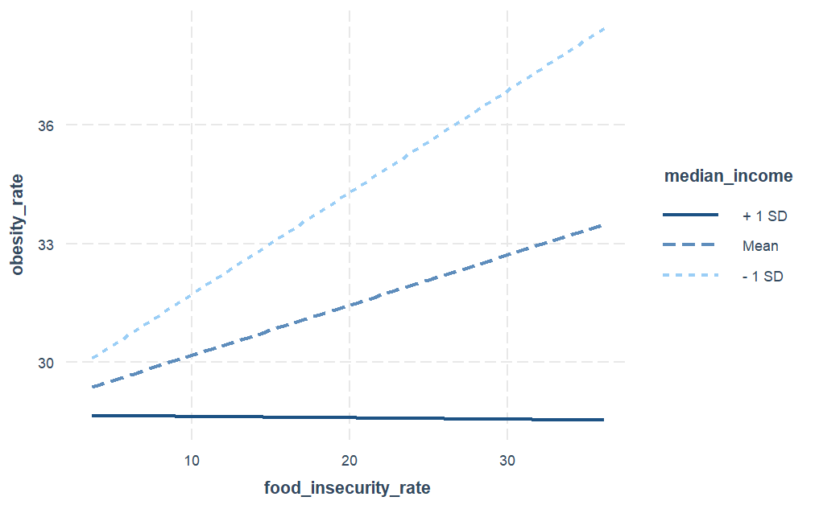
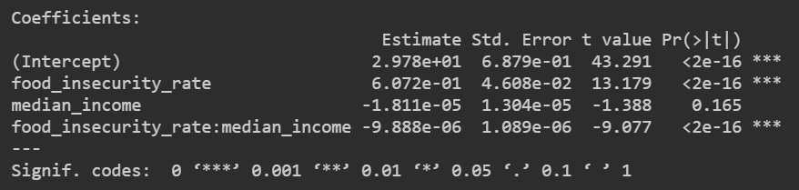
Moderation Analysis w/ Median Income
Significant moderation
Negative moderation:
As median income increases, the relationship decreases

Slide 12
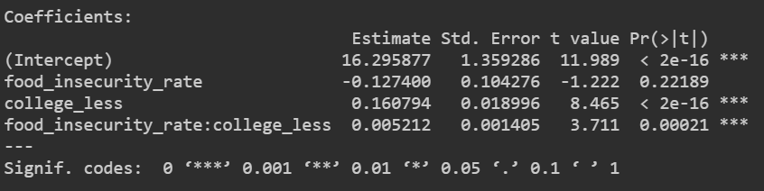
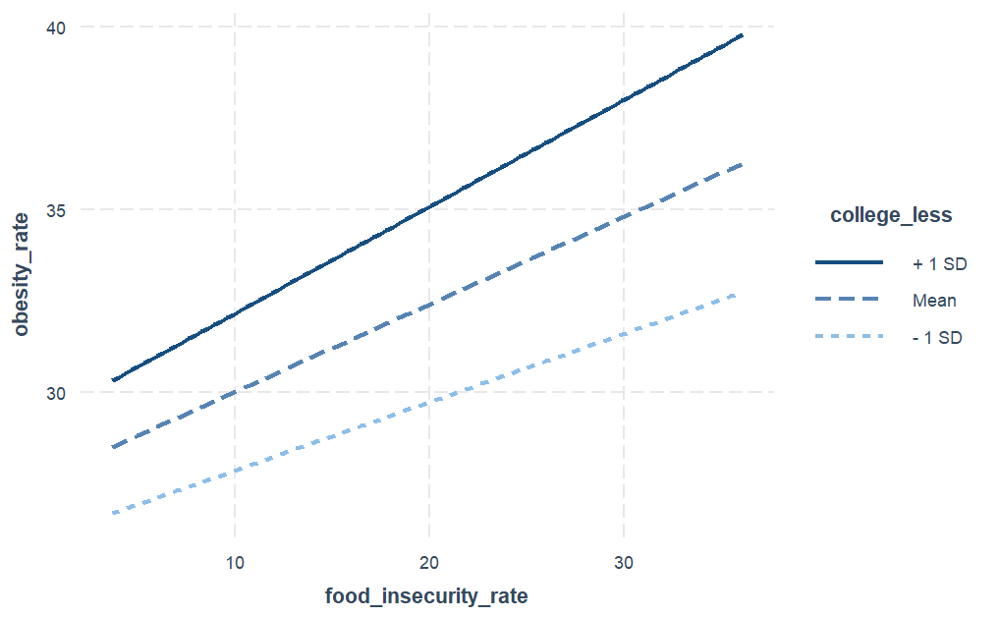
Moderation w/ Less than College Edu.
Significant moderation
Positive moderation:
As levels of less than college education increases, the relationship increases

Slide 13
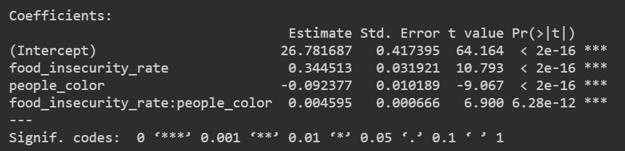
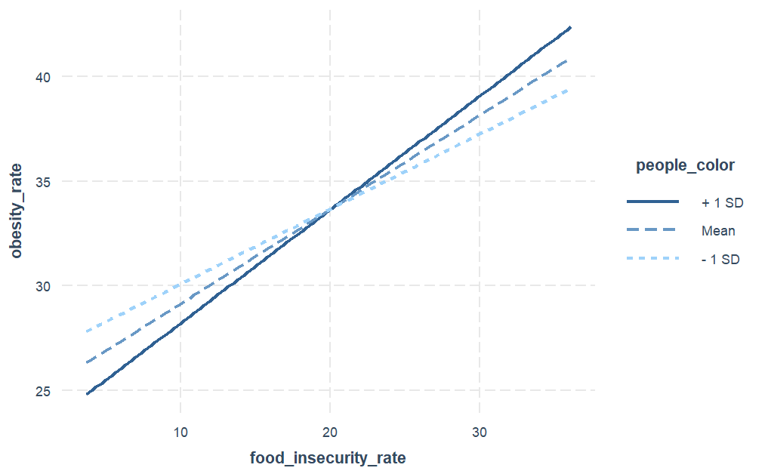
Moderation Analysis w/ POC
Significant moderation
Positive moderation:
As levels of people of color increase, the relationship increases

Slide 14
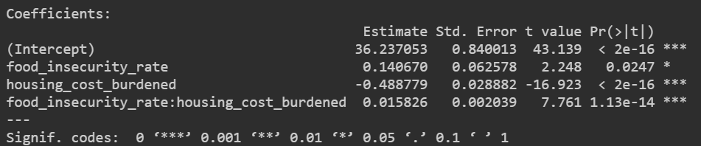
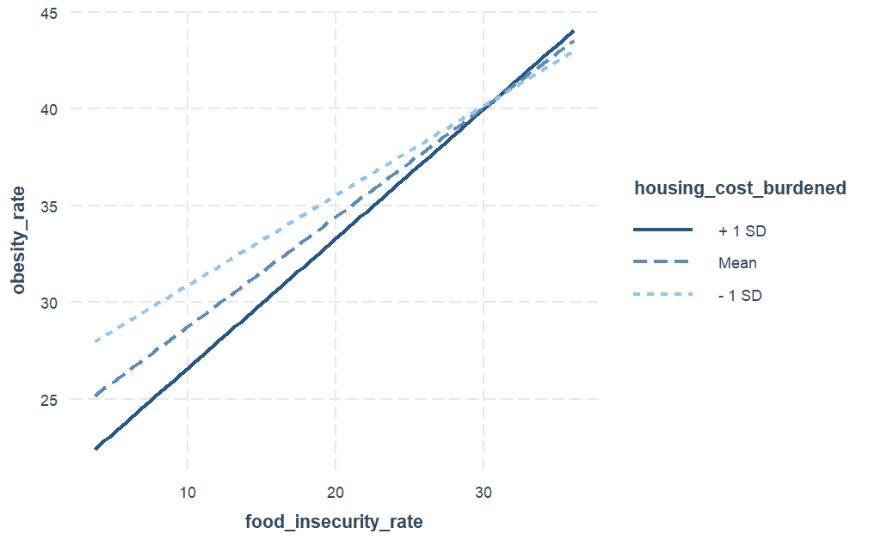
Moderation w/ Housing Cost Burden
Significant moderation
Positive moderation:
As housing cost burden increases, the relationship increases

Slide 15
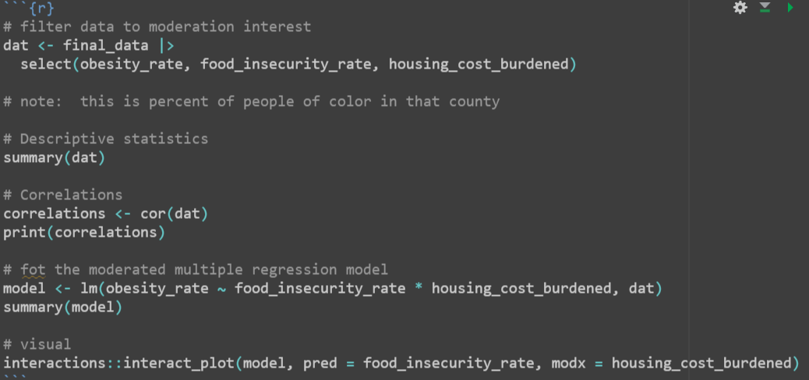
The code we used
Notes:
Look at the interact map function

Slide 16
03
More Visualizations
We wanted to create a county-level map for every single variable.

Slide 17
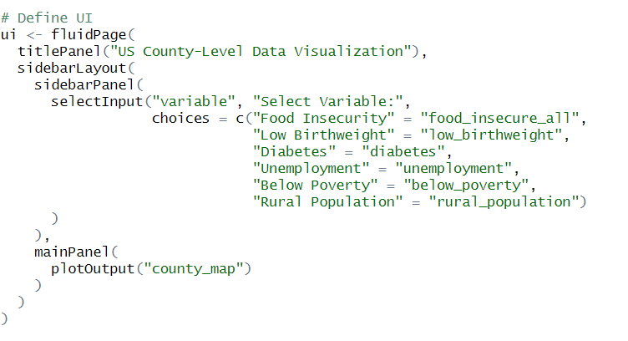
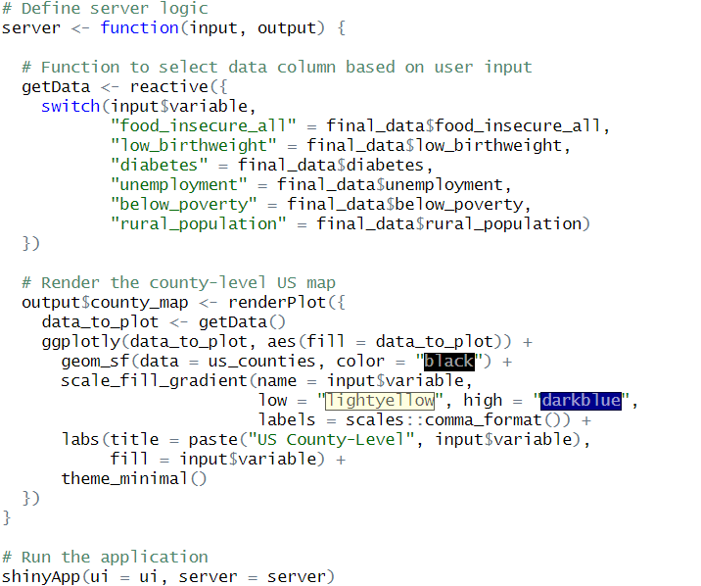
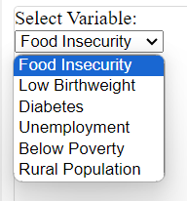
Visualizations of Variables - In Progress
We are working on creating a shiny app that has a drop down menu where the user can select a variable they want to look at from our data.
Notes:
Load the updated rmd on your computer and have the tab with the interactive map in the background so that you could show the class the interactivity during the presentation

Slide 18
05
Report Update
A lot of time was spent on the report this week, we are aiming to have it done by next week.

Slide 19
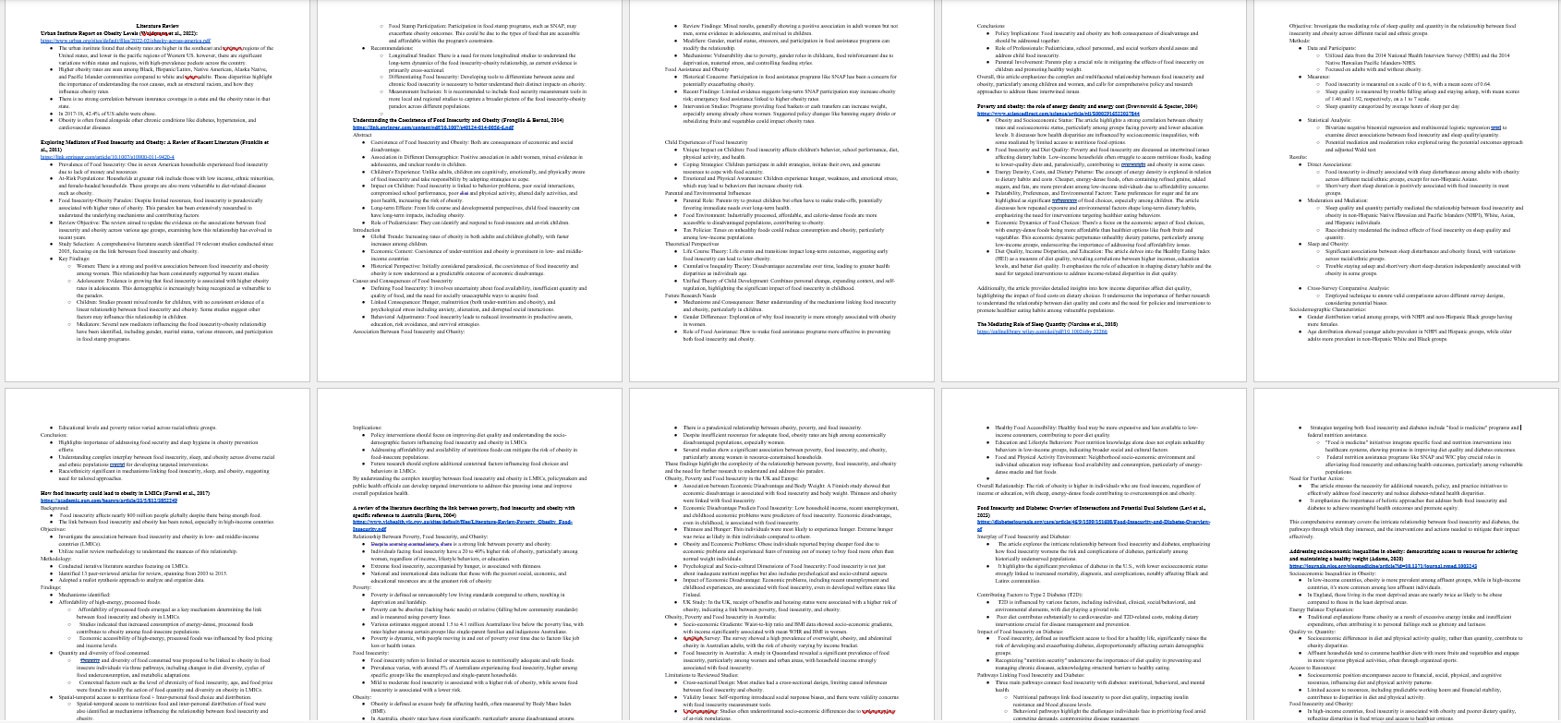
Report Update - Literature Review
We spent a lot of time conducted an extensive literature review in order to determine what variables would be most suitable to use in our moderation analysis.

Slide 20
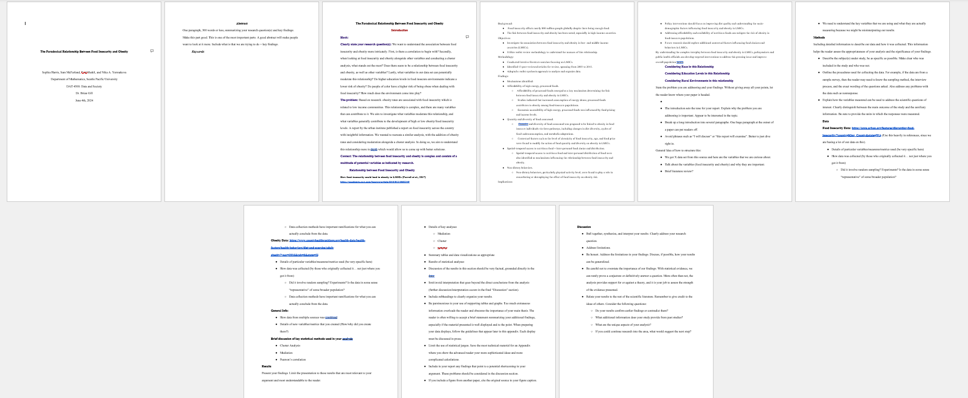
Report Update - Introduction + Outline
We outlined the entire paper in detail and are ready to plug information in. We spent majority of the time focusing on how to format the introduction since we wanted to include a lot of information there.

Slide 21
06
Next Steps

Slide 22
Next Steps
Next week we want to focus on wrapping everything up - Visualizations, Report, and GitHub.
Finalize the Report
Write out the sections outlined
Get the paper reviewed so that the last week will just be spent on revisions.
Make visualizations interactive and ensure that they follow proper visualization principles
County-Level Maps of Variables
Cluster Map
Correlation Graph
Moderation Graphs
Work on Github
Make sure all the technical aspects are functional
Figure out how to create links within the report

